Slide 1
DRAFTY

Slide 2

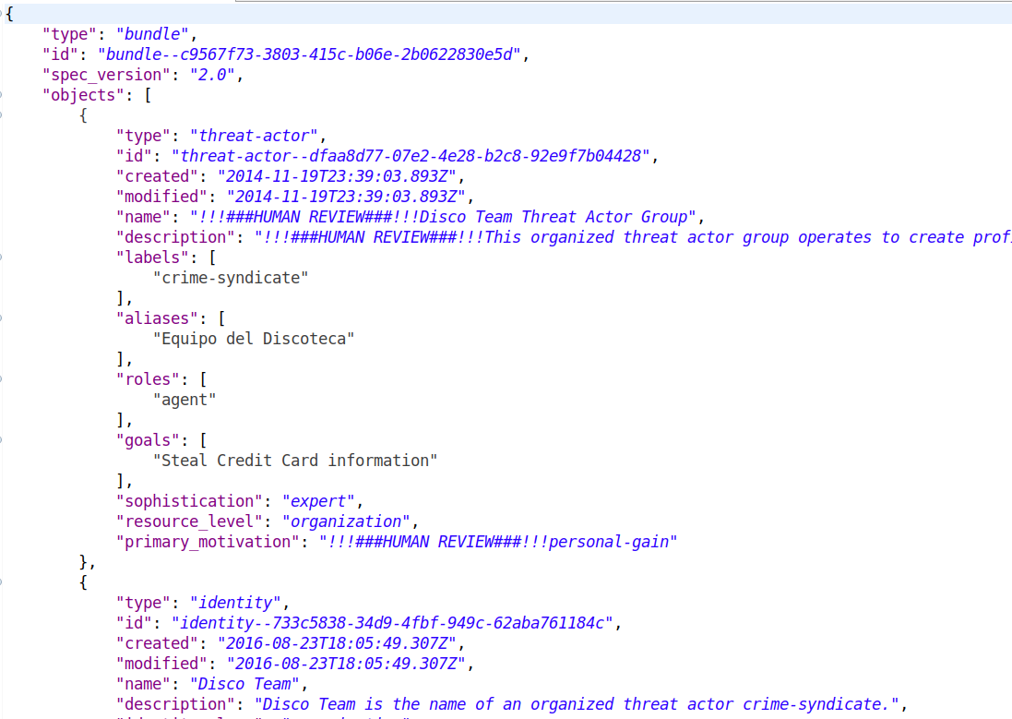
1
Active MQ
2
3
4
MySQL
HR UI
(NodeJS)
HR Backend (Spring Boot)
HR Partner
(Spring Boot)
5
6
Active MQ

Slide 3
High level flow of HR Yellow Dog App.
A Stix Document (with marking) inserted to a queue
Backend ingests the doc and parse for HR fields
Doc and HR fields are saved in DB
User pulls HR, reviews & disseminates
Backend disseminates the modified Stix doc
Modified doc is now available for partner

Slide 4
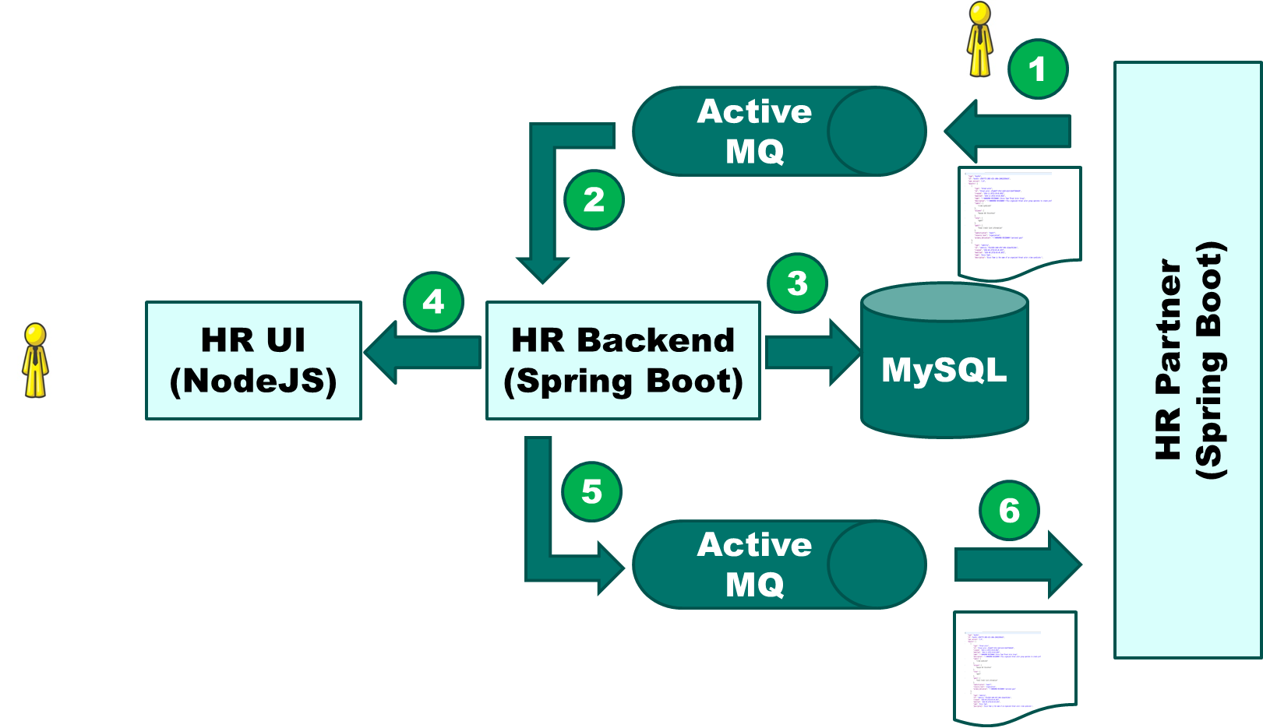
Unit tests with JEST (87%+)
Unit tests with Junit (93%+)

Slide 5
Web Driver Interactions
REST API Interactions
HR UI Automated Tests
(Java – Serenity/Cukes – Selenium Web Driver – REST API)

Slide 6
REST API Interactions
REST API Interactions
HR Backend (API) Automated Tests
(Java – Serenity/Cukes –REST API)

